Slide 1

WasteWise: An Agentic AI for Smart Waste Management
Presented by: Team : MAVERICS
A project for the AI Summer Certification Program :
From Learner to Builder: Become an AI Agent Architect.

Slide 2

The Global Waste Crisis: A Call to Action
Modern societies generate over 2 billion tonnes of municipal solid waste annually, a staggering figure that highlights an urgent global challenge.
Inefficient Manual Segregation
Environmental Catastrophe
Current waste management relies heavily on manual sorting, a process that is inefficient, hazardous for workers, and costly. This leads to alarmingly low recycling rates.
Improper waste disposal contributes significantly to environmental pollution, contaminating land, water, and air, and accelerating climate change.
The AI Opportunity
Leveraging an agentic AI framework offers a scalable, non-invasive, and efficient solution to automate waste analysis, improve sorting accuracy, and foster public engagement.

Slide 3

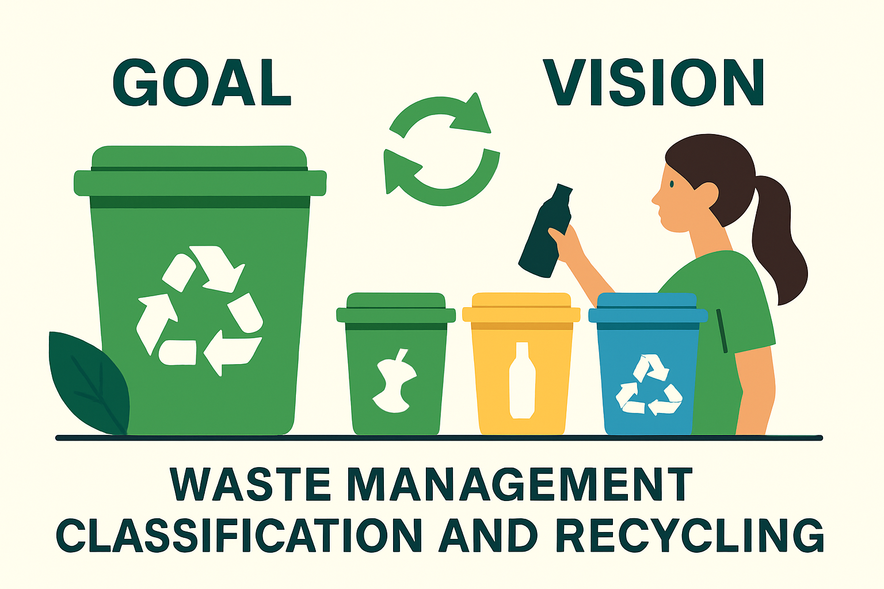
WasteWise: Our Vision and Goals
Our project's core objective is to develop and deploy WasteWise, an agentic AI system designed to accurately classify waste from images, identify its components, and incentivize responsible disposal through a gamified scoring system.
01
Gemini-powered Vision Analysis
Utilize the Google Gemini model as our core Classifier Agent to perform rapid and accurate vision analysis, categorizing waste from a single user-uploaded image.
02
Agentic Component Identification
For mixed waste, deploy a specialized Separator Agent to intelligently identify, count, and categorize each item, creating a detailed routing plan for subsequent treatment.
03
Automated Recycling and Treatment Protocol
Route identified components to dedicated treatment workflows, including a Recycling Protocol for non-biodegradable items and specific protocols for biodegradable and e-waste, ensuring proper simulated handling.
04
Automated User Engagement Loop
Implement a database-driven "Honor Score" and use Relay.app to automatically send email confirmations, creating a complete and rewarding feedback loop for the user. Also provide reward for the user based on honor score.

Slide 4


Aligning with Global Sustainability Goals
SDG 11: Sustainable Cities and Communities
SDG 12: Responsible Consumption and Production
WasteWise proudly supports the United Nations Sustainable Development Goals,
positive change for a healthier planet. A smart and efficient tool for municipal waste management
contributes in providing a cleaner and livable urban environment.
By promoting accurate recycling and proper waste disposal, WasteWise encourages sustainable consumption patterns, minimizing environmental impact and maximizing resource efficiency.

Slide 5
WasteWise's Multi-Agent Architecture
1. User Input
1
Users upload a waste image via a simple interface, initiating the analysis process.
2
2. Master Classifier Agent
Performs a high-level classification of the entire scene, setting the context for detailed analysis.
3. Component Recognition Agent
3
Employs object detection to identify and localize individual waste items (e.g., plastic bottle, apple core).
4
4. Dispatch & Specialized Agents
Identified components are routed to domain-expert agents:
Biodegradable Agent (e.g., apple core: suggests composting)
5. Honor Score Agent
5
Recycling Agent (e.g., plastic bottle: confirms recyclability)
Analyzes component insights, calculates a user score, and updates their profile in our secure database.
E-Waste Agent (e.g., battery: provides special disposal instructions)

Slide 6
Our Modern Technology Stack
WasteWise is built on a foundation of modern, powerful technologies, leveraging Google's advanced AI for intelligent processing and a streamlined user
Core AI Engine: Google Gemini:
Our system is powered by the Gemini-1.5-flash model, which handles all intelligent tasks from initial image classification to detailed
component identification using its advanced multimodal capabilities.
Application Framework: Streamlit
We use Streamlit to build and serve the interactive web interface, allowing users to easily upload images and view
the real-time results of our agentic workflow.
Backend & Automation: Python & Relay.app
Python is the core language used for all agent logic and service integration. Relay.app manages our automated user engagement loop
by sending email confirmations and Honor Score updates.
Agentic Logic: Custom Python Functions
Our system uses a lightweight, custom agentic framework where each Python function (classifier_agent_process, separator_agent_process,
etc.) acts as a specialized agent to perform a distinct task in the processing chain.
Database: MongoDB
We use MongoDB as our NoSQL database solution to securely store all user data and track the Honor Scores awarded for each submission
creating a persistent record of user engagement.

Slide 7

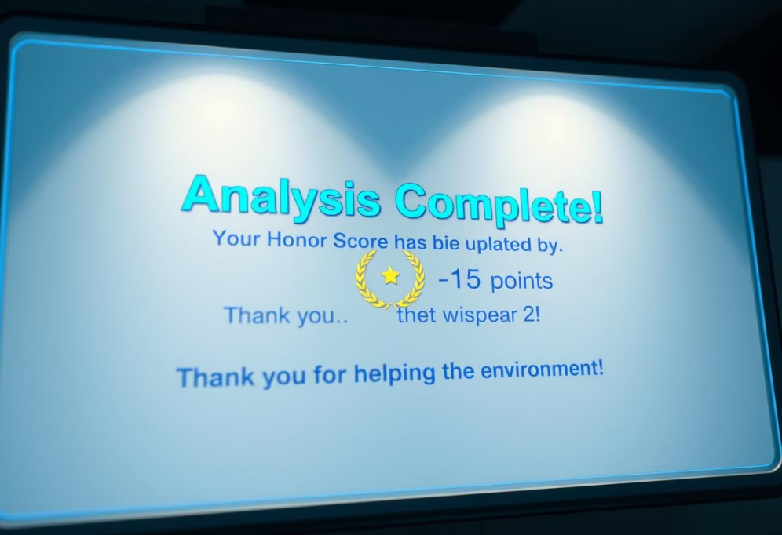
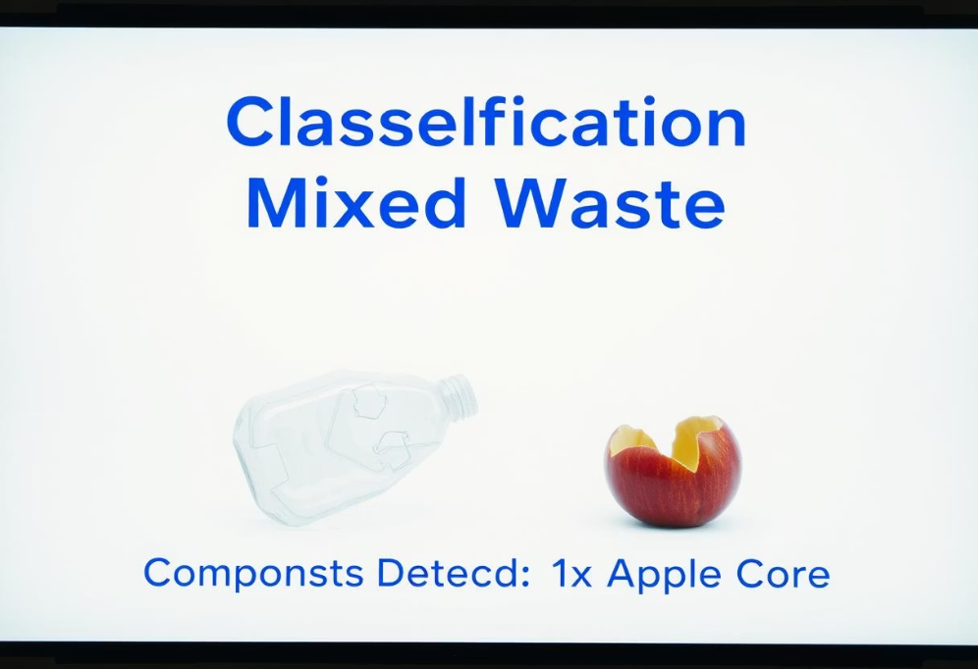
WasteWise in Action: Seamless Waste Intelligence
1
2
3
Waste Upload & Analysis
Classification & Component Output
Honor Score Update
Users effortlessly upload images of their waste, initiating EcoAgent's intelligent analysis.
Every responsible disposal earns points, updating the user's Honor Score and reinforcing positive environmental behavior.
The system provides a precise classification and detailed breakdown of detected components.

Slide 8
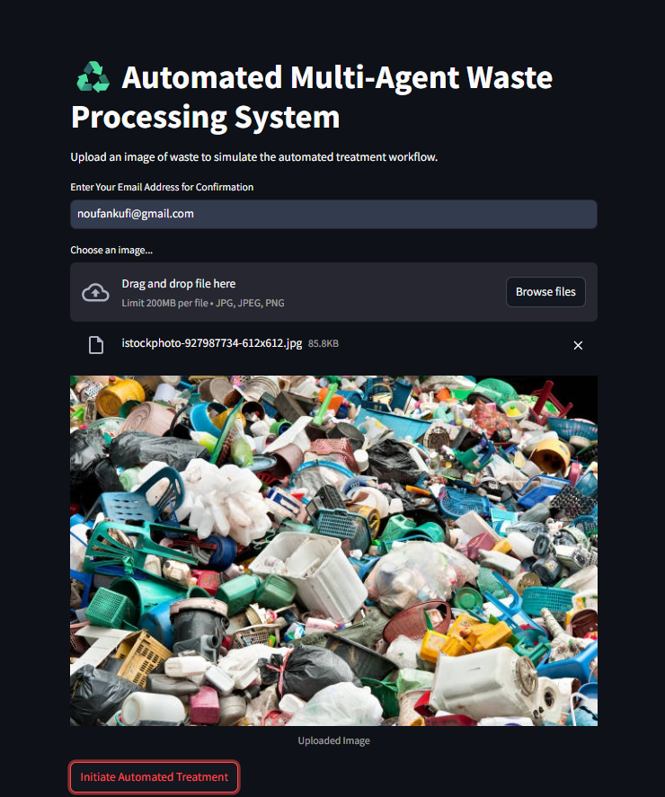
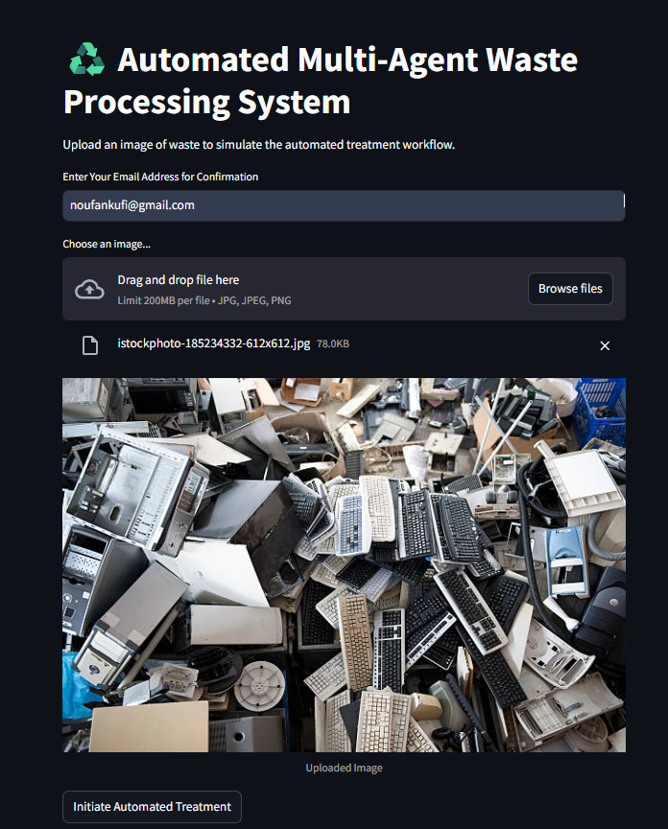
OUTPUT
Mixed Waste
E-Waste

Slide 9
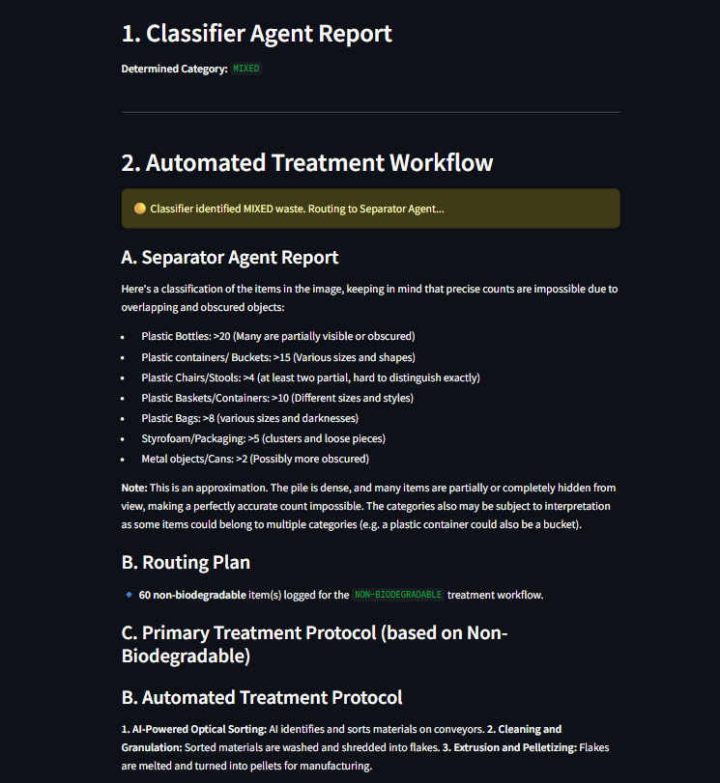
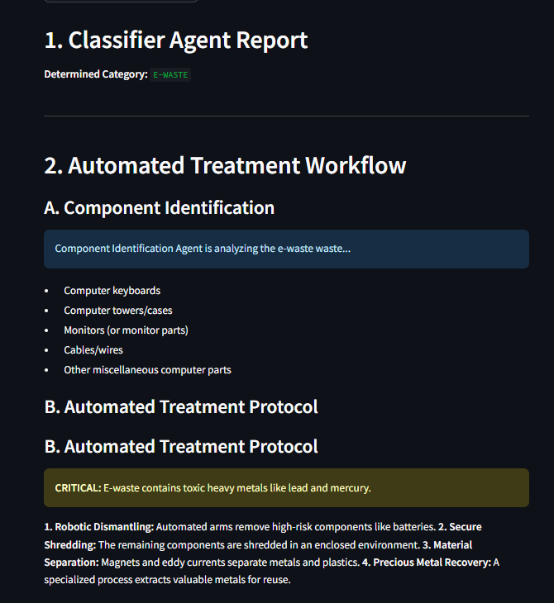

Slide 10
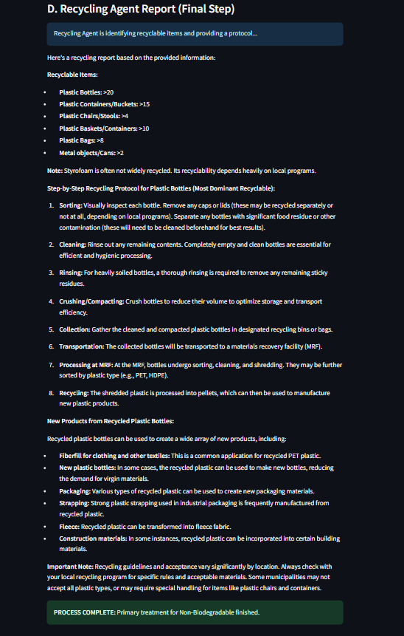
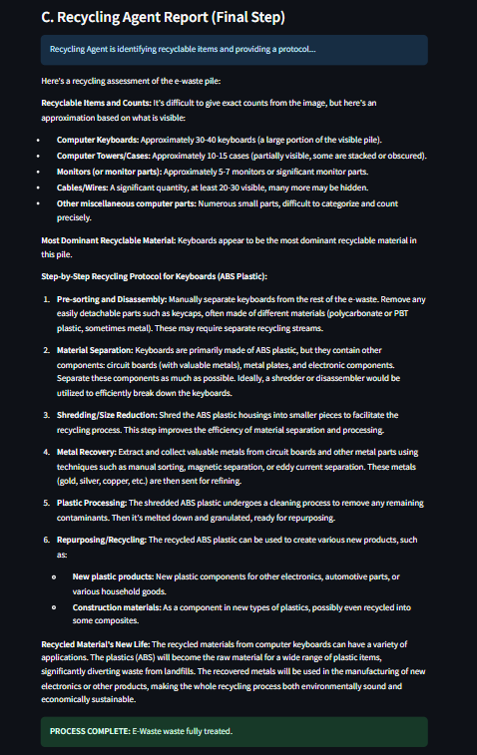

Slide 11
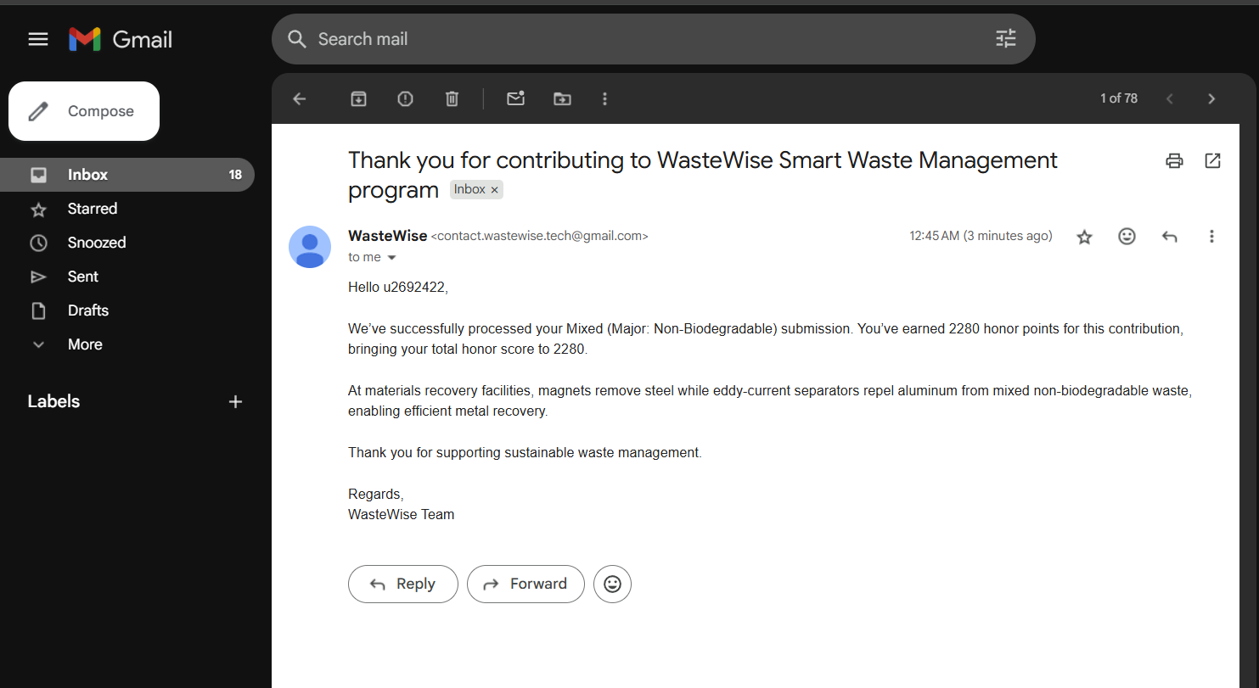
Mail Feedback (using relay.app)
MIXED WASTE

Slide 12
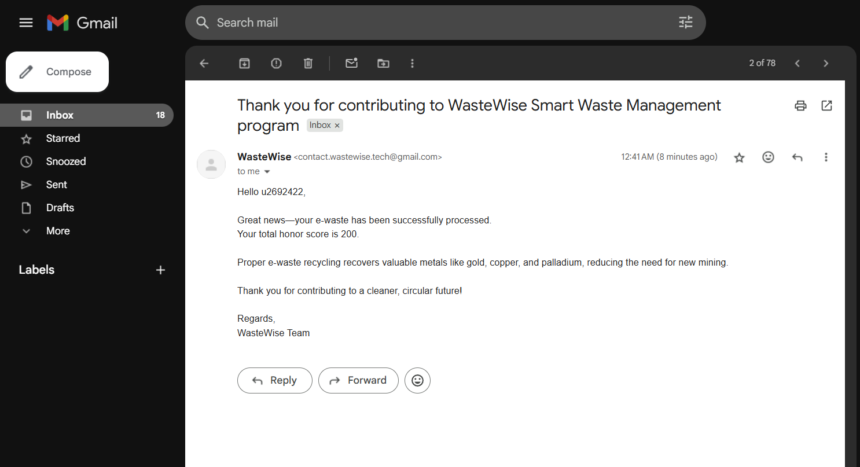
Mail Feedback (using relay.app)
E-WASTE

Slide 13





Transformative Impact & Scalability
Automated Efficiency
WasteWise replaces slow, manual sorting with an instant, agent-driven workflow. From image upload to the final treatment protocol, the entire process is automated, making proper waste management accessible and highly efficient for everyone.
Data-Driven Insights
The system gathers invaluable real-world data on user waste habits and segregation quality through the Honor Score. This information can empower municipal planning, inform targeted educational campaigns, and measure the effectiveness of sustainability initiatives.
Continuous Improvement
Our model is designed for continuous learning, constantly improving its accuracy and relevance with new data inputs, ensuring long-term effectiveness.
Scalable Solution
Built with a modern stack including Streamlit and MongoDB, WasteWise is inherently scalable. Its unique user engagement loop, powered by Relay.app, allows it to be easily integrated into community portals, educational platforms, or corporate wellness programs to promote sustainable habits.

Slide 14

https://github.com/THE-MAVERICS/Waste_Wise.git

Slide 15

Conclusion & Future Horizons
WasteWise successfully demonstrates the transformative power of agentic AI in tackling complex, real-world environmental challenges. By orchestrating a cooperative system of specialized agents, we have forged a solution that is not only technically proficient but also engaging and impactful.
Key Takeaways
Future Work
Agentic AI provides a powerful framework for complex problem-solving.
Develop a full-fledged mobile application for broader accessibility.
Integrate with local municipal services for location-specific disposal advice.
Gamification significantly enhances user engagement in environmental initiatives.
Expand the Honor Score system with leaderboards and real-world rewards to foster community participation.
Scalable cloud infrastructure is crucial for real-world impact.

